Slide 1


<Name>
<Date>

Slide 2

Outline
Executive Summary
Introduction
Methodology
Results
Conclusion
Appendix

Slide 3
Executive Summary
Summary of methodologies
Summary of all results

Slide 4
Introduction
Project background and context
Problems you want to find answers

Slide 5

Section 1

Slide 6
Methodology
Executive Summary
Data collection methodology:
Request to the SpaceX API
Clean the requested data
Perform data wrangling
Perform exploratory Data Analysis
Determine Training Labels
Perform exploratory data analysis (EDA) using visualization and SQL
Perform interactive visual analytics using Folium and Plotly Dash
Perform predictive analysis using classification models
Data Preparation , Model Building , Model Tuning , Model Evaluation

Slide 7
Data Collection
In this step, I requested to the SpaceX API , downloaded datasets to compile the initial raw data needed for my project and I clean the requested data.
Identify Data Sources: Request and parse the SpaceX launch data using the GET request.
Data Parsing: I used BeautifulSoup library to parse the data because they were in HTML format and extract the information that I was need.
Data Structuring: Structure the data in a data frame format and select the necessary columns , renaming come of them and converting the data types .
Data Saving: Save the structured data to a CSV file .

Slide 8
Data Collection – SpaceX API
Here is the flowcharts =>
GitHub URL : https://github.com/ChrisLoukas007/IBM-Data-Science-Assignments/blob/main/Applied%20Data%20Science%20Capstone/Space%20X%20-%20Data%20Collection%20.ipynb
Start
|
V
Identify API Endpoints
|
V
Send API Requests
|
V
Parse API Responses
|
V
Structure Data
|
V
Save Data
|
End

Slide 9
Data Collection - Scraping
Start
|
V
Identify Target Web Pages
|
V
Send HTTP Requests
|
V
Parse HTML Responses
|
V
Structure Data
|
V
Save Data
|
End
Here is my web scraping process flowcharts =>
GitHub URL : https://github.com/ChrisLoukas007/IBM-Data-Science-Assignments/blob/main/Applied%20Data%20Science%20Capstone/Space%20X%20-%20Web%20Scraping.ipynb

Slide 10
Data Wrangling
In this notebook “Space X - Data wrangling.ipynb” I followed these steps:
Load Data: Load the data into a pandas DataFrame from the previous section .
Exploratory Data Analysis (EDA): Perform initial investigations on data to discover patterns, spot anomalies, test hypotheses…
Determine Training Labels: Based on the objectives of my analysis, determine the training labels.
Doing some important calculations : e.g. Count the number of launches for each launch
Create Landing Outcome Label: Create a new label from the 'Outcome' column to represent the landing outcome.
Here is the flowchart : Start -> Load Data -> EDA -> Training Labels -> Calculations -> Outcome Label -> Export to CSV
Add the GitHub URL is : https://github.com/ChrisLoukas007/IBM-Data-Science-Assignments/blob/main/Applied%20Data%20Science%20Capstone/Space%20X%20-%20Data%20wrangling.ipynb

Slide 11
EDA with Data Visualization
Load Data : Load the SpaceX launch data into a pandas DataFrame
EDA : Perform initial investigations on data to discover patterns, spot anomalies and so on…
Data Visualization: Plot charts to understand relationships between variables: ( Flight Number vs. Launch Site, Payload vs. Launch Site , Success Rate vs. Orbit Type , Flight Number vs. Orbit Type , Payload vs. Orbit Type , Launch Success Yearly Trend )
Feature Engineering : Modify data to improve model performance : ( Create dummy variables for categorical columns , Cast numeric columns to float64)
Flowchart: Start - > Load Data --> EDA --> Data Visualization --> Feature Engineering -> Export
GitHub URL: https://github.com/ChrisLoukas007/IBM-Data-Science-Assignments/blob/main/Applied%20Data%20Science%20Capstone/Space%20X%20-%20Data%20Visualization.ipynb

Slide 12
EDA with SQL
Connect to Database: Establish a connection with the SpaceX database.
Unique Launch Sites: Retrieve unique launch sites.
'CCA' Launch Sites: Find launch sites starting with 'CCA'.
NASA (CRS) Payload: Calculate total payload mass for NASA (CRS) launches.
F9 v1.1 Payload: Compute average payload mass for F9 v1.1 booster version.
First Ground Pad Success: Identify date of first successful ground pad landing.
Drone Ship Success Boosters: List boosters with successful drone ship landings and specific payload mass.
Mission Outcomes: Count successful and failed mission outcomes.
Max Payload Boosters: Identify booster versions that carried the maximum payload mass.
2015 Records: Display specific records for the year 2015.
Rank Landing Outcomes: Rank landing outcomes between specific dates.
GitHub URL : https://github.com/ChrisLoukas007/IBM-Data-Science-Assignments/blob/main/Applied%20Data%20Science%20Capstone/Space%20X%20-%20SQL.ipynb

Slide 13
Build an Interactive Map with Folium
Markers: These were used to mark all launch sites on the map. Each marker represents a launch site, providing a visual representation of where SpaceX has launch sites.
Circles: Circles were used to mark the success or failure of launches for each site on the map. The color of the circle indicates whether the launch was a success (green) or a failure (red). This allows for a quick visual assessment of the success rate of launches from each site.
Lines: Lines were used to calculate and display the distances between a launch site and its proximities. This helps to understand the geographical context of each launch site, such as its distance from coastline, cities, and other points of interest.
The reason for adding these objects was to provide a visual and interactive way to explore and understand the SpaceX launch data. By visualizing this data on a map, patterns and insights can be more easily discovered and understood
GitHub URL: https://github.com/ChrisLoukas007/IBM-Data-Science-Assignments/blob/main/Applied%20Data%20Science%20Capstone/Visual%20Analytics%20with%20Folium%20.ipynb

Slide 14
Build a Dashboard with Plotly Dash
Bar Plots: These could have been used to represent categorical data. Bar plots provide a visual representation of data distribution across different categories.
Line Graphs: These could have been used to represent trends over time. Line graphs are excellent for showing changes in data over time, especially when there are many data points.
Scatter Plots: These could have been used to represent relationships between two numerical variables. Scatter plots are great for identifying correlations and patterns in the data.
Dropdowns, Sliders, and Buttons: These interactive elements could have been added to allow users to filter and manipulate the data displayed on the dashboard. This allows users to explore the data in a more detailed and personalized way.
The reason for adding these plots and interactions is to provide a comprehensive, interactive, and user-friendly way to explore and understand the data. By visualizing this data in a dashboard, users can discover patterns, trends, and insights more easily.

Slide 15
Predictive Analysis (Classification)
Data Preprocessing: This step involves cleaning the data, handling missing values, and converting categorical data into numerical data. This is crucial for preparing the data for the machine learning model.
Feature Selection: This step involves selecting the most relevant features for the model. This can be done using various statistical methods and by understanding the domain knowledge.
Model Building: Several classification models could have been built using different algorithms such as Logistic Regression, Decision Trees, Random Forest, etc.
Model Evaluation: Each model could have been evaluated using appropriate metrics such as accuracy, precision, recall, F1 score, etc. This helps in understanding how well each model is performing.
Model Improvement: Based on the evaluation, the models could have been improved by tuning the hyperparameters, using different feature selection methods, or even trying different algorithms.
Model Selection: The model that performed the best on the evaluation metrics could have been selected as the final model.
GitHub URL: https://github.com/ChrisLoukas007/IBM-Data-Science-Assignments/blob/main/Applied%20Data%20Science%20Capstone/SpaceX%20-%20ML%20Prediction.jupyterlite.ipynb

Slide 16
Results
Exploratory data analysis results
Interactive analytics demo in screenshots
Predictive analysis results

Slide 17

Section 2

Slide 18
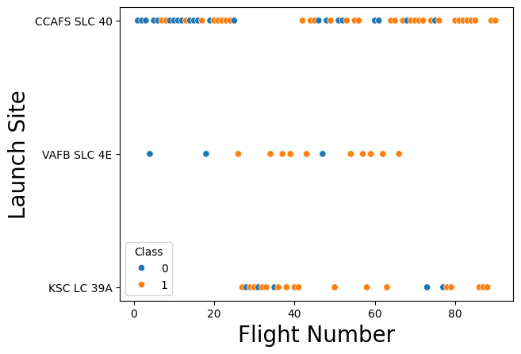
Flight Number vs. Launch Site
Explanation: The resulting scatter plot would allow you to visually explore the relationship between payload mass and launch site, and how these relate to the class value. For example, you might be able to see if certain launch sites tend to have higher payload masses, or if the class value tends to be different for different payload masses or launch sites.

Slide 19
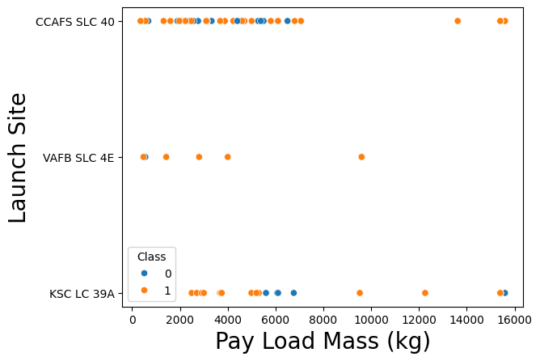
Payload vs. Launch Site
Show a scatter plot of Payload vs. Launch Site
Explanation: The resulting scatter plot would allow you to visually explore the relationship between payload mass and launch site, and how these relate to the class value. For example, you might be able to see if certain launch sites tend to have higher payload masses, or if the class value tends to be different for different payload masses or launch sites.

Slide 20
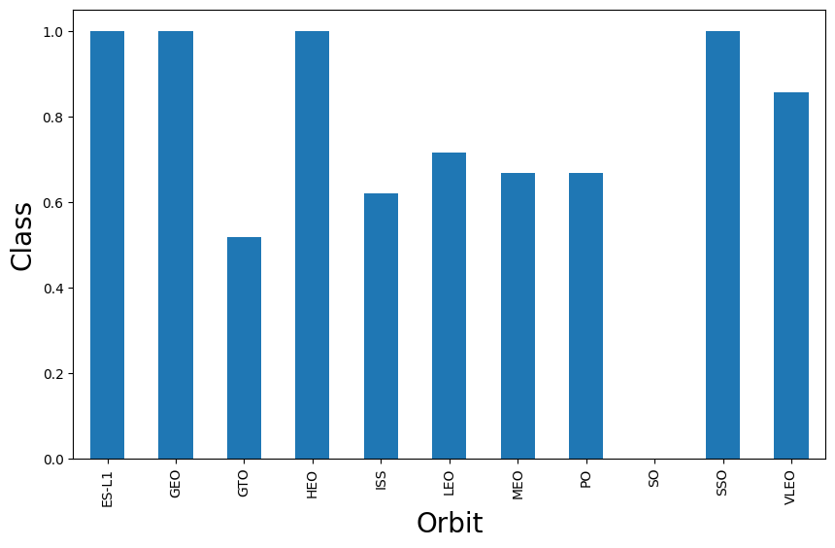
Success Rate vs. Orbit Type
Explanation: The resulting bar chart would allow you to visually explore the relationship between the orbit type and the average class value. For example, you might be able to see if certain orbits tend to have higher or lower average class values.

Slide 21
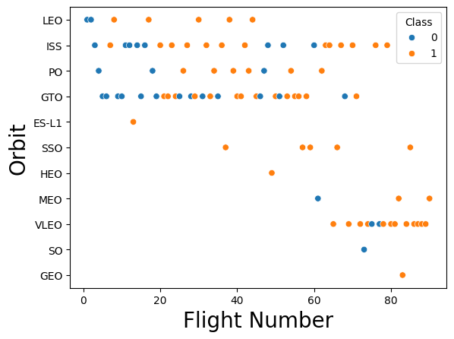
Flight Number vs. Orbit Type
Explanation : The resulting scatter plot would allow you to visually explore the relationship between flight number and orbit, and how these relate to the class value. For example, you might be able to see if certain orbits are more common for certain flight numbers, or if the class value tends to be different for different flight numbers or orbits.

Slide 22
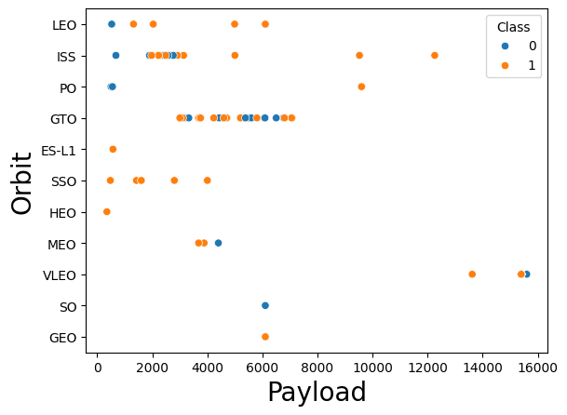
Payload vs. Orbit Type
Explanation : The resulting scatter plot would allow you to visually explore the relationship between payload mass and orbit, and how these relate to the class value. For example, you might be able to see if certain orbits are more common for certain payload masses, or if the class value tends to be different for different payload masses or orbits.

Slide 23
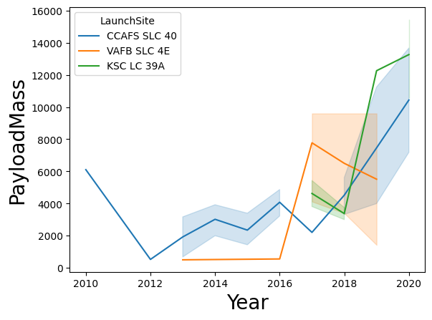
Launch Success Yearly Trend
Explanation : The resulting line plot would allow you to visually explore the relationship between year and payload mass, and how these relate to the launch site. For example, you might be able to see if certain launch sites tend to have higher payload masses in certain years, or if the payload mass tends to increase or decrease over the years for each launch site.

Slide 24
All Launch Site Names
Launch sites : CCAFS SLC-40 , KSC KL-39A , VAFB SLC-4E
%sql SELECT DISTINCT Launch_Site FROM SPACEXTBL

Slide 25
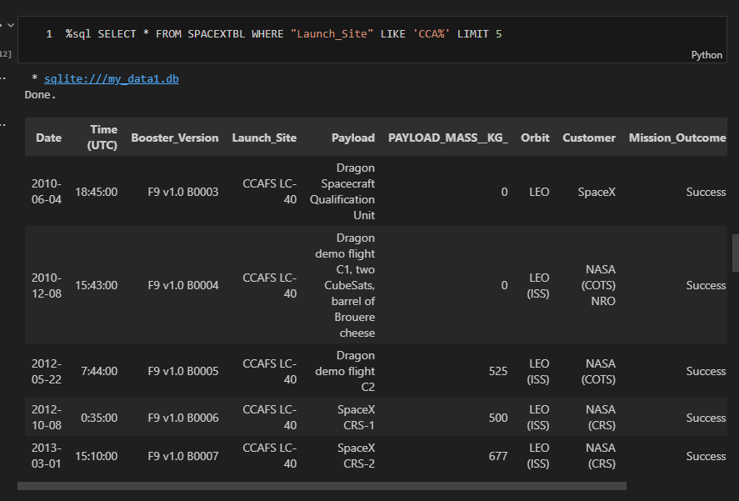
Launch Site Names Begin with 'CCA'
5 records where launch sites begin with `CCA`

Slide 26
Total Payload Mass
Query: ‘ %sql SELECT COUNT(*) FROM SPACEXTBL WHERE "Customer" LIKE 'NASA (CRS)%’
The result is : 21
Explanation : This query will return the total payload mass for all rows where the "Customer" column contains 'NASA (CRS)'. Please replace PayloadMass with the actual column name in your table that represents payload mass. The SUM function is used to calculate the total of the PayloadMass column for the selected rows. The LIKE keyword in the WHERE clause is used to select rows where the "Customer" column contains 'NASA (CRS)'.

Slide 27
Average Payload Mass by F9 v1.1
%sql SELECT AVG("PAYLOAD_MASS__KG_") FROM SPACEXTBL WHERE "Booster_Version" LIKE 'F9 v1.1%’
The result is : 2534.6666666666665
Explanation : This SQL query calculates the average payload mass for the SpaceX missions where the booster version is like 'F9 v1.1'.

Slide 28
First Successful Ground Landing Date
%sql SELECT MIN("Date") FROM SPACEXTBL WHERE "Landing_Outcome" = 'Success’
The result is : 2018-07-22
Explanation : This SQL query finds the earliest date of a successful landing in the SpaceX missions.

Slide 29
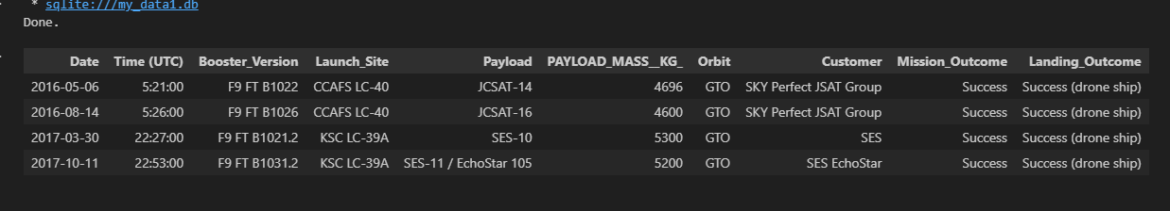
Successful Drone Ship Landing with Payload between 4000 and 6000
%sql SELECT * FROM SPACEXTBL WHERE "Landing_Outcome" = 'Success (drone ship)' AND "PAYLOAD_MASS__KG_" > 4000 AND "PAYLOAD_MASS__KG_" < 6000
Present your query result with a short explanation here

Slide 30
Total Number of Successful and Failure Mission Outcomes
Total number of successful mission outcomes : %sql SELECT COUNT(*) FROM SPACEXTBL WHERE "Mission_Outcome" = 'Success’
Result : 98
Total number failure mission outcomes : %sql SELECT COUNT(*) FROM SPACEXTBL WHERE "Mission_Outcome" = 'Failure’
Result : 0

Slide 31
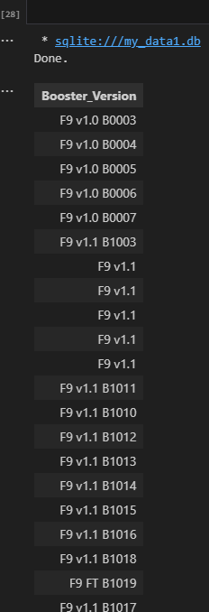
Boosters Carried Maximum Payload
%sql SELECT "Booster_Version" FROM SPACEXTBL WHERE "Payload_Mass" = (SELECT MAX("Payload_Mass") FROM SPACEXTBL)

Slide 32
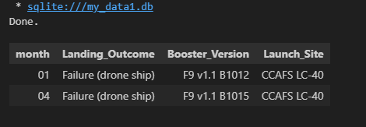
2015 Launch Records
%sql SELECT substr("Date", 6,2) as month, "Landing_Outcome", "Booster_Version", "Launch_Site" FROM SPACEXTBL WHERE "Landing_Outcome" LIKE 'Failure (drone ship)%' AND substr("Date",0,5)='2015'

Slide 33
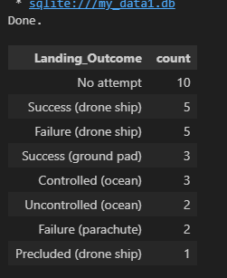
Rank Landing Outcomes Between 2010-06-04 and 2017-03-20
%sql SELECT "Landing_Outcome", COUNT(*) as count FROM SPACEXTBL WHERE "Date" BETWEEN '2010-06-04' AND '2017-03-20' GROUP BY "Landing_Outcome" ORDER BY count DESC

Slide 34

Section 3

Slide 35
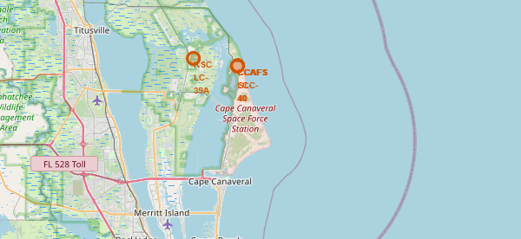
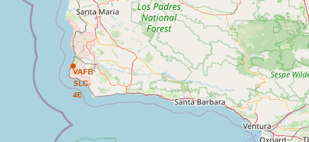
All launch sites on the map
First, I load the launch site data, which should include the geographical coordinates (latitude and longitude) of each site.
Then create a base map using Folium. You can set the initial location of the map to the average coordinates of all launch sites to center the map.
For each launch site, I create a marker using its coordinates and add it to the map. I customize the popup label of each marker to display the name of the launch site.
Finally, I display the map with all the markers.

Slide 36
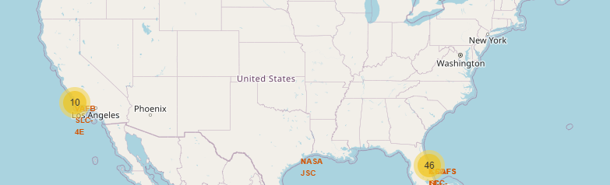
In the screenshot, you can see a detailed folium map centered around a selected launch site. The map shows various elements in proximity to the launch site, such as railways, highways, and the coastline.
Launch Site Marker: This is the central point from which distances to nearby features are calculated. It's represented by a distinct marker.
Proximity Features: These are the nearby features like railways, highways, and the coastline. They are usually represented by lines or markers with different colors or symbols to distinguish between them.
Distance Lines and Labels: These are lines drawn from the launch site to the nearby features, with labels showing the calculated distances. This gives a clear visual representation of how close these features are to the launch site.
Findings: The proximity of these features to the launch site can have various implications. For example, being close to a highway can facilitate transportation of equipment and personnel. Being near a coastline allows for over-water launches, which can enhance safety and allow for easier recovery of reusable rocket stages. The specific findings would depend on the exact distances and the particular features near the selected launch site.
Proximity Analysis of Selected Launch Site

Slide 37
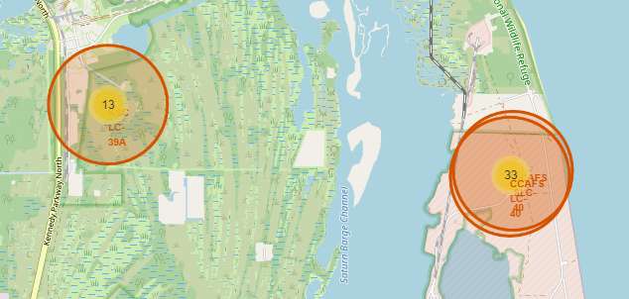
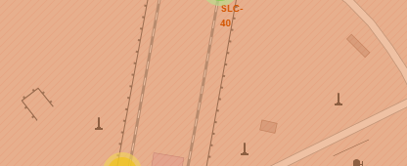
The distances between a launch site to its proximities

Slide 38

Section 5

Slide 39

Confusion Matrix

Slide 40
Conclusions
Space X - Data Collection .ipynb: This notebook contains the code and processes used to collect the SpaceX data. This involve API calls, web scraping, accessing databases.
Space X - Web Scraping.ipynb: This notebook is dedicated to collecting data from the web, from the SpaceX website. It use libraries like BeautifulSoup .
Space X - Data wrangling.ipynb: This notebook is used for cleaning and preprocessing the collected data. Tasks include handling missing values, data type conversion, and data transformation.
Space X - SQL.ipynb: This notebook contains SQL queries used to interact with a database containing SpaceX data. It involve data extraction, manipulation, and analysis using SQL.
Space X - Data Visualization.ipynb: This notebook is used to create visualizations of the SpaceX data. It use libraries like Matplotlib, Seaborn, or Plotly to generate charts and graphs.
Visual Analytics with Folium .ipynb: This notebook contains geographical visualizations of the SpaceX data. It uses the Folium library to create interactive maps showing launch sites and other geographical data

Slide 41
Conclusions
SpaceX - ML Prediction.jupyterlite.ipynb: This notebook contains a machine learning model that makes predictions based on the SpaceX data. It involve model training, evaluation, and prediction.

Slide 42


